Slide 1
Decentralized Social Media Network Using Blockchain
Project Guide – V. V. Kheradkar

Slide 2
Abstract
Most social media sites extract the data for his or her benefit.
Lack of trust, transparency and control over data.
So, need for decentralized platform.
Blockchain technology has made applications distributed, decentralized without loss of security.

Slide 3
Problem Statement
Implement fully decentralized social media network for users and to share contents over network in peer to peer manner without storing data on centralized server.

Slide 4
Keywords
Node
Ethereum Network
Distributed and Decentralized platform
Authentication and security
Transparency
Hash value and Transaction
Interplanetary File System (IPFS)
Angular and TypeScript
System Testing and Maintenance
Smart Contract

Slide 5
Objectives
To study in detail existing centralized applications and need of blockchain to overcome existing problems in centralized system.
To implement fully decentralized social media network using blockchain.
To store data in decentralized storage network and give ownership to users.

Slide 6
Limitations and Scope
Limitations for traditional system :
Centralization of data
Social media piracy
Less productivity
Lack of Transparency and Security
Scope of proposed system :
Decentralized system
Transparency
Increased security and productivity

Slide 7
Literature Survey
Minds
Steem
Pocketnet

Slide 8
Requirement Analysis
User Interface Requirements :
User should be able to register him/her on the application.
User must create his profile in application.
Friend request and acceptance facility should be provided.
User should be able to chat with others in textual and Emoji format.
User should be capable to back up the data on his own device.
Keep log in facility must be there.
Search friends these functions should be provided.

Slide 9
Requirement Analysis contd…
Hardware interface requirements :
Visual studio code – it used for develop and deploy the frontend code.
Microsoft Azur portal- It is used for integration of project.
Browser – to run the application
Web3 JS – to connect Ethereum and angular
remix IDE- to develop the contracts and deploy for getting the ABI code
Linux OS platform- to develop and run the Ethereum network.

Slide 10
Requirement Analysis contd…
Modular/ Component Requirements :
Network formation – Forming peer to peer network using geth node.
Smart contract - This module contains business logic and functionality in the form of smart contract.
web app - We are developing social media web app.
Interplanetary File System (IPFS) – This module contains code of storing data on IPFS platform.

Slide 11
Implementation
Environmental setting for running a module.
Installation of Node.
Creation of Ethereum Network.
Creating Account.
Editor for front end developing.

Slide 12
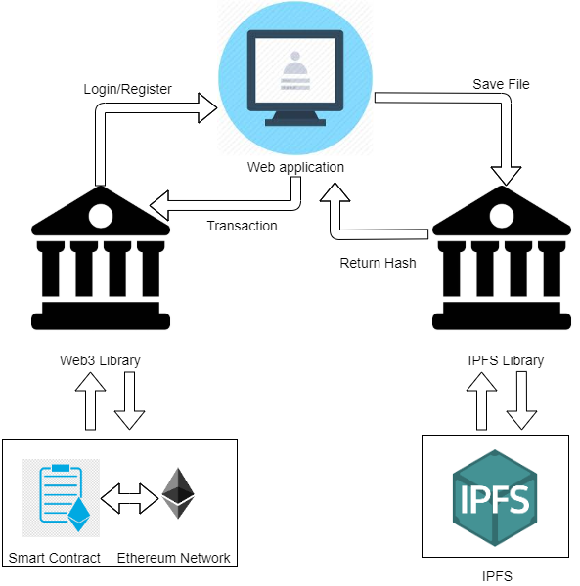
System Designs
Architecture Diagram :

Slide 13
System Diagram contd…
Components in Architecture diagram :
User interface
Web3 and IPFS libraries
Network
Smart contract
IPFS storage

Slide 14
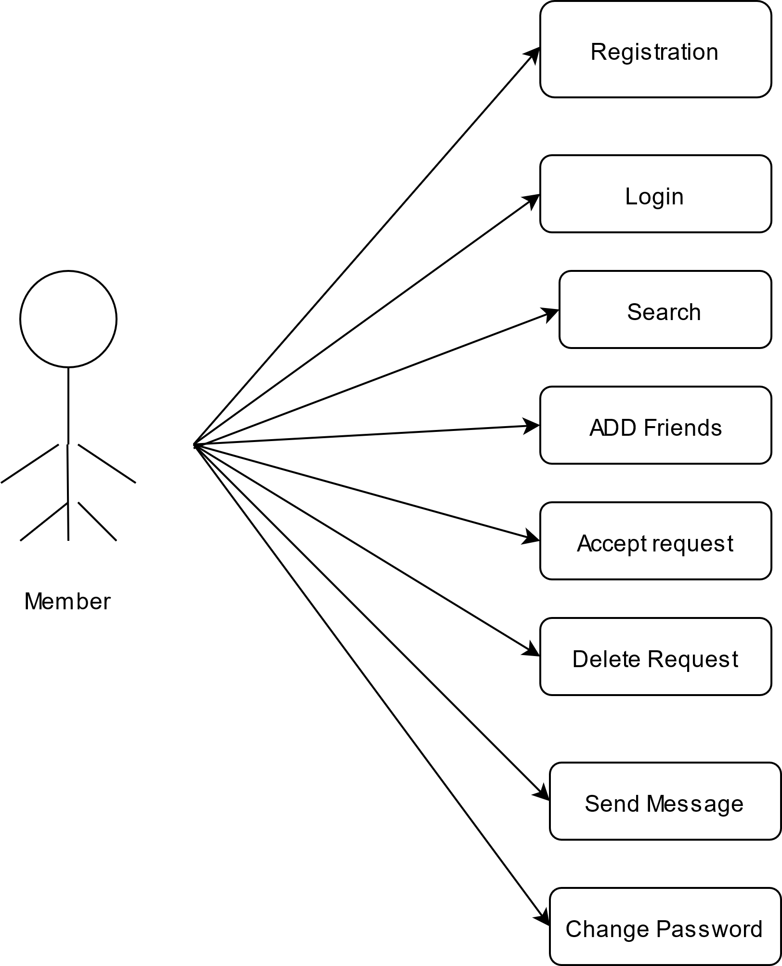
System Diagram contd…
Use Case Diagram

Slide 15
System Diagram contd…
Algorithm for each module :
Find friend algorithm
Password recovery algorithm
Content showing algorithm
Send and Accept friend request algorithm

Slide 16
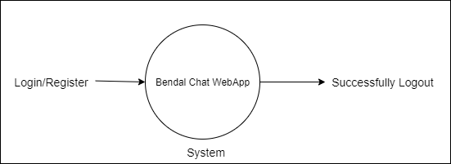
System Diagram contd…
Data Flow Diagram
DFD-0

Slide 17
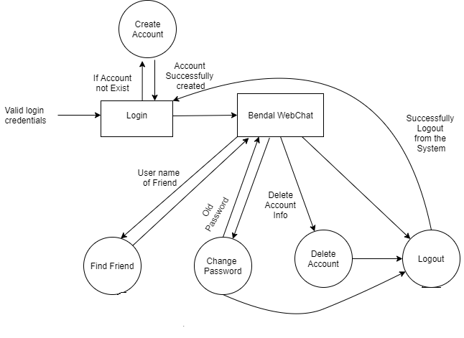
System Diagram contd…
Data Flow Diagram
DFD-1

Slide 18
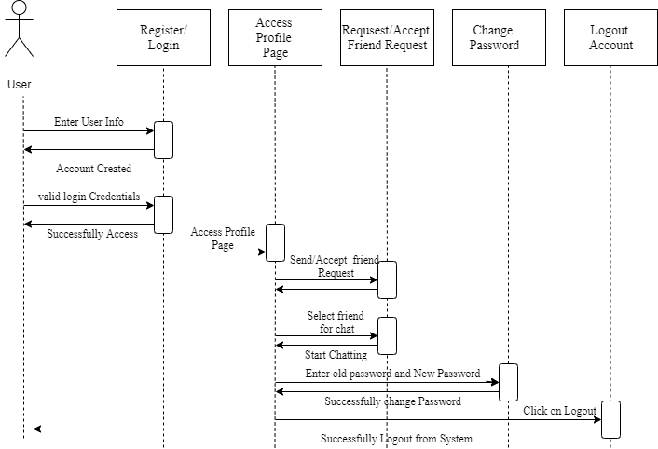
System Diagram contd…
Sequence diagram

Slide 19
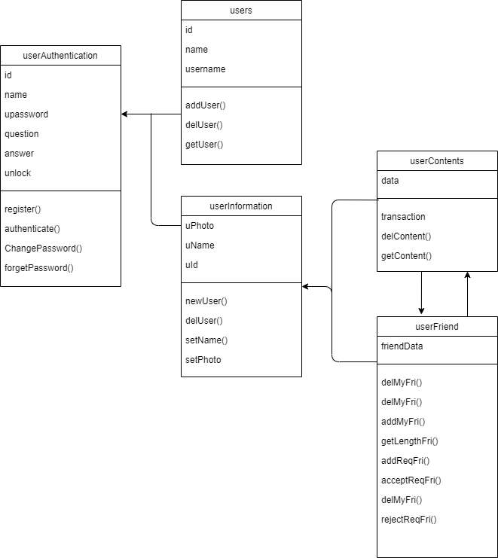
System Diagram contd…
Class Diagram

Slide 20
Performance Analysis
Companies providing services have authority over person’s information
People don’t even think while agreeing or signing polices that give companies power to use customers data
There is loss of personal privacy and transparency
This problem is solved using blockchain decentralized systems
This platform can run without a central authority imposing its own rules during human interaction
The user can have control of their private data, and the freedom of expression is restored without the fear of censorship or backlash.

Slide 21
Future Scope of the project
Trending groups suggestion for joining can be provided.
Privacy criteria like notification allow/blocked, new message, message seen etc can be provided.
New group formation.
Content - Copy, Delete, Share, Forward facility should be provided.

Slide 22
Applications
Crowd Funding platform.
Platform for solving Environmental issues and social issues.
User can raise money for his original contents.
Gain popularity by more interactivity with platform.

Slide 23
Conclusion
Users will be able to show the content and be able to set their restrictions and constraints.
Determine how and where data should be distributed.
User will have full control over private data.
No more storing it on centralized servers and losing it when these servers go down or when their security gets breached.

